Slide 1

CPRG 210 Web Application Development
Module 1: Introduction to HTML

Slide 2
Outlines
WEB Concepts
HTML Basics
Hyper Text Markup Language
Tags: Basic Tags, Self-Closed Tags, Block/Container Tags (<p>, <h1>, <div>, Special Tags (&lt, &reg)
Tools: Text Editor & Browser
Comments
Lists (ordered, unordered)
Hyperlinks (Anchor) (email, internal/external links)
Tables
Images
icons

Slide 3
Resources
http://www.w3.org
http://www.w3schools.com/
http://www.webpagesthatsuck.com/
http://www.webmonkey.com/
http://dev.w3.org/html5/html4-differences/Overview.html

Slide 4
Concepts: WEB
World Wide WEB (WWW)
Collection of Interlinked E-Documents (Websites)
Each E-Document Called Web Page
Accessed Via Internet
Web Page
Text, Graphics, Tables, Links, Lists
Audio and Video

Slide 5
Concepts: Web Site
Web Site
File Management
Collection of Related Web Pages
Presenting Content to World
Home Page: 1st Page
Has Links to other Web Pages
Every web project will have it's own project folder
With Notepad++ create a new document and save it as index.html inside the project folder
webdev
index.html

Slide 6
Concepts: Webpage Name
Guidelines
Allowed: Letters, Digits, Underscores
1st Character should be a Letter
Extension: HTML/HTM
Not Allowed: Spaces, Special Characters, etc.
Capitalization Matters in Linux

Slide 7

Concepts: Webpage Components
Content
Layout & Structure
Presentation
Interactivity
7

Slide 8
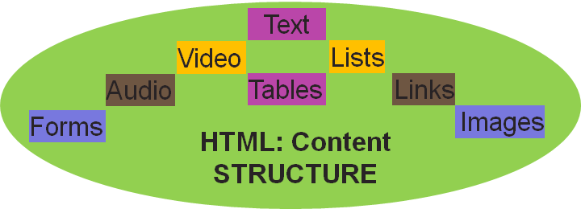
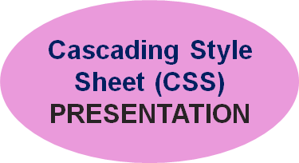
Concepts: HTML & CSS
HTML & CSS: Static Website
Content
+
Structure
HTML
+
CSS
Presentation
=
Web site
Interactive/Dynamic Website?

Slide 9
Systems Development Life Cycle (SDLC)
System Investigation
System Analysis
System Design
Our Focus
System Implementation
System Testing &
Maintenance
9

Slide 10
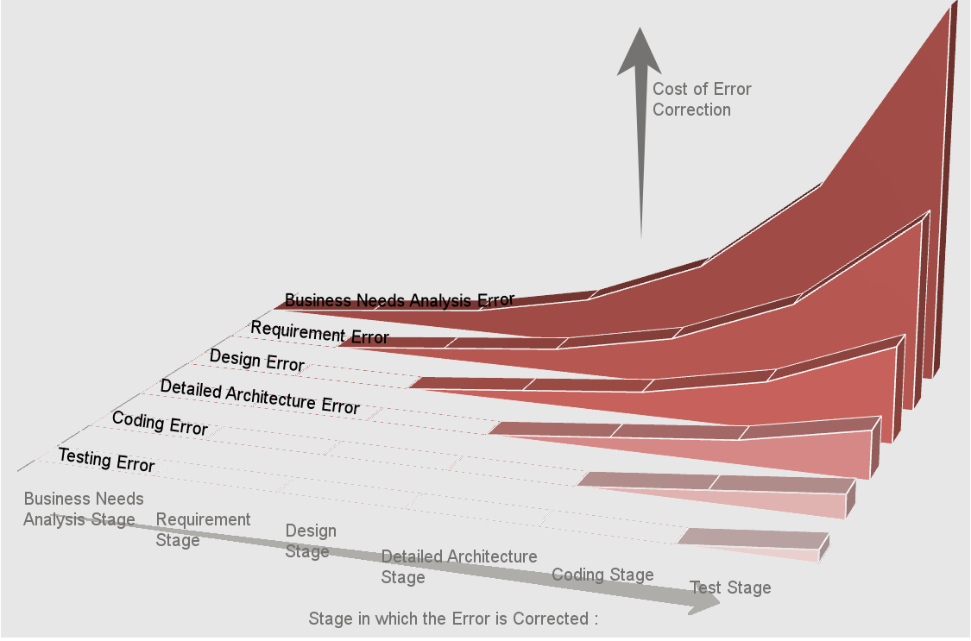

Systems Development Life Cycle (SDLC)
Error Type
Correction Stage
10

Slide 11
HTML Concepts
HTML
Hyper Text Markup Language
Language of WEB Pages
Text-Format Language
HTML File = Text Files
Created by a Text Editor
Extension: HTML or HTM

Slide 12
HTML Concepts
Hyper Text
Markup
Links Within Web Pages
Markup = Symbols or Codes
Connect One Page to Another
Telling Browser How to Display a Page
Language
Called Elements/Tags
Understood by WEB Browser
Center, Boldface, Bullets, etc.
HTML 5: Latest version - Has numerous new tags (elements)
Many of the HTML5 tags require CSS and JavaScript in order to be useful
Many tags and attributes from HTML 4.01 are removed
More detail tomorrow

Slide 13
HTML: Software Tools
HTML: Editors
HTML: Text Files
Many Editors
Programs With HTML Assistance
Examples
 | WINDOWS | MAC
Free | Notepad | TextEdit
 | Notepad++ | Smultron
HTML: Browser: Testing/Viewing Web page

Slide 14
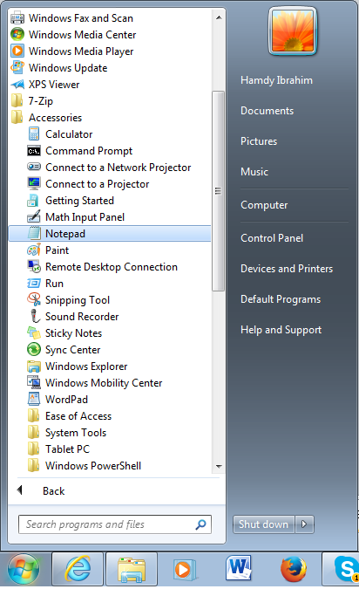
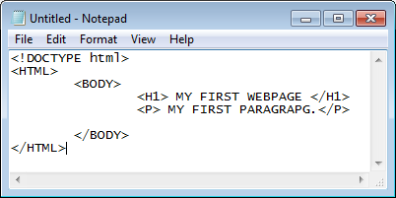
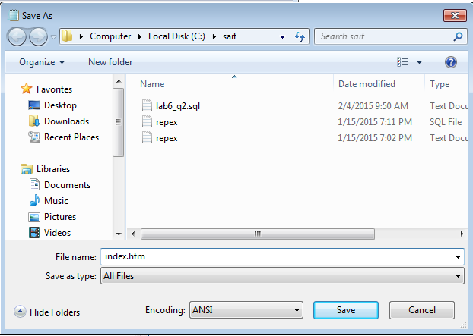
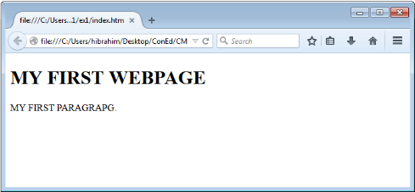
HTML: Development Process
Assumption: Analysis & Design are completed
(1) Open Notepad
(2) Writing HTML CODE
(4) Testing
(3) Save as HTM/HTML

Slide 15
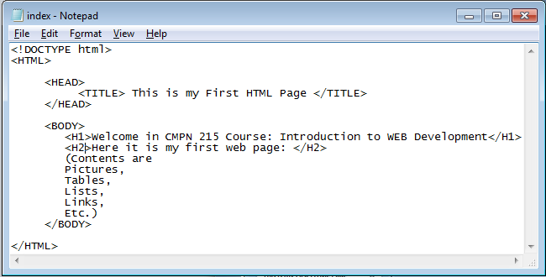
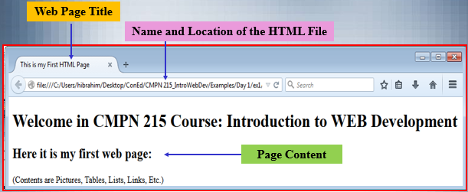
HTML: Basic Structure/Layout
File name
HTML File = Web page
Contain HTML <tags> and plain text
Describe content of web pages
Document Type Declaration
Information about the Web Page
Web Page Title
HTML Tags
Nested Elements: close inner tag first
Page Content
Notes:
The <!DOCTYPE html> declaration defines this document to be HTML5
The <html> element is the root element of an HTML page
The <head> element contains meta information about the document
The <title> element specifies a title for the document
The <body> element contains the visible page content

Slide 16
HTML Elements
HTML Element
<TagName> content </Tagname>
<TagName>: Start/Open Tag
</TagName>: End/Close Tag
<TITLE> This is my First HTML Page </TITLE>
Open Tag | Content | Close Tag
<H1> | My 1st Heading | </H1>
<P> | My 1st Paragraph | </P>
<BR> | Self Closed <BR />
Container Tags
Empty Element/Tags: No Content → e.g. <hr />

Slide 17
HTML Tags
HTML Tags
Used to Add Content & Structure Web pages
Tag name is in lower case
Tell the Browser How to Display Content
Attributes: Additional Information about Element – Added to Open Tag
Attribute_Name=“value”
<img src="w3schools.jpg“ width="104" height="142">
<p align=“right”>contents</p>
<h1 align=“right” width=“300” size=“4” >contents</h1>

Slide 18
<!--Comment Tag-->
<!-- …-->
Inserting comments to Improve Code Readability
Ignored By the Browsers
Can be One or More Lines
<HTML>
<HEAD>
<TITLE>CMPN 215</TITLE>
</HEAD>
<BODY>
<!-- Welcome in CMPN 215 Course
All About Web Development -->
</BODY>
</HTML>
Write notes to yourself
Hide sections of content
Can be used for debugging

Slide 19
WEB Page Content
TEXT
Spaces, TABS, and Blank Lines: Ignored
Paragraph <p>
Headings (H1-H6): Mark Major Sections
<PRE></PRE>: Display text as typed
<HR> & Break Line <BR>

Slide 20
Paragraph & Headings
<HTML>
<HEAD>
<TITLE> Example Page</TITLE>
</HEAD>
<BODY>
</H1> Heading 1 </H1>
<P> Paragraph 1, ….</P>
<H2> Heading 2 </H2>
<P> Paragraph 2, ….</P>
<H3> Heading 3 </H3>
<P> Paragraph 3, ….</P>
<H4> Heading 4 </H4>
<P> Paragraph 4, ….</P>
<H5> Heading 5 </H5>
<P> Paragraph 5, ….</P>
<H6> Heading 6</H6>
<P> Paragraph 6, ….</P>
</BODY>
</HTML>
Heading 1
Paragraph 1,….
Heading 2
Paragraph 2,….
Heading 3
Paragraph 3,….
Heading 4
Paragraph 4,….
Heading 5
Paragraph 5,….
Heading 6
Paragraph 6,….

Slide 21
Common Empty Tags
Line Break <br />
Horizontal Rule <hr />
<hr width=“300” /> or <hr width=“80%” />
<hr size=“4” />
<hr align=“left” /> (or center, or right)
<hr noshade />
Check reference pages for “deprecated” attributes
Many attributes are obsolete due to CSS
Container tags?
<p>, <h1> to <h6>, <div>, etc.
Notes:
Alignment
<p align=“right”>contents</p>
also left and center
<h1 align=“right”>contents</h1>
also left and center
<div> -- used to enclose a block of tags, setting alignment & style etc. for entire block

Slide 22

Special HTML Characters
&lt; → less than
&gt;→ greater than
&copy; → Copyright Sign
&reg; → Registered Sign
&eacute; → Capital E, Acute Accent
&nbsp; → Non Breaking Space
https://brajeshwar.github.io/entities/
specialcharacters.html

Slide 23
HTML Lists
Series of items displayed or printed together.
They are widely used as links
They help in organizing of data
Quick and easy to create
Definition & Why
Ordered List
to begin ordered list
<ol>
<li> list item 1 </li>
<li> list item 2 </li>
</ol> to end ordered list
Ordered/Numbered List
List Item
<ol type = “1” start = “3”>
1: Numbers (default) | I: Uppercase Roman | i: Lowercase Roman
A: Uppercase Alphabetic | a: Lowercase Alphabetic

Slide 24
HTML Lists
to begin a list
<ul>
<li> Item 1 </li>
<li> Item 2 </li>
</ul>
Unordered - Bulleted List
<ul type = “circle”> <ul type = “round”> <ul type = “square”>
Nesting lists
<ul>
<li> item 1 </li>
<ol>
<li> item 1.1 </li> <li> Item 1.2 </li>
</ol>
<li> item 2 </li>
</ul>

Slide 25
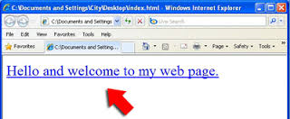
HTML Links/Hyperlinks
Pointer to another Webpage, Image, or Website
Text or Image – Easily Browsing
<a href=“page1.html”> Page 1 </a>
Anchor Tag
Webpage/URL
Closing Tag
Hypertext Reference
Link Name
<a href=“http://www.sait.ca”> Go to SAIT </a>

Slide 26
HTML Links/Hyperlinks
Linking to a local file
Absolute/relative addresses
<a href=“c:\myfile.html”>click here</a>
<a href=“myfile.html”>click here</a>
<a href=“html/myfile.html”>click here</a>
<a href=“../myfile.html”>click here</a>
Internal links (links to sections in the same webpage)
<a href=‘#xxx’> </a>
NEVER:
Hard code an absolute path to a link (i.e. <a href = ”c:\work\index.html”>)
Best to use a relative path

Slide 27
HTML Links/Hyperlinks
Linking within a list
<ul>
<li><a href=“here.html”>click here</a> </li>
<li><a href=“there.html”>click there</a> </li>
</ul>
Linking to FTP Servers
<a href=‘ftp://ftp.netscape.com’>Netscape FTP</a>
Linking to Multimedia
<a href=‘soundfile.wav’>Click for sound</a>
Linking to Email
<a href=‘mailto:hpeters@dlcwest.com’>Send me an email</a>

Slide 28
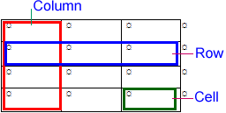
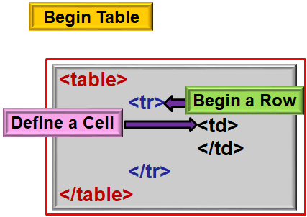
HTML Tables
Table: Rows and Columns
Organizing Data
Enhancing Webpage Appearance
Raging debate:
Should tables be used?
Depends on the situation
If displaying data, such as database results, row/column output, then YES.
If formatting page or controlling layout, then NO.
Some of the arguments:
http://www.dreamincode.net/forums/topic/243037-div-vs-table-requesting-enlightenment/

Slide 29
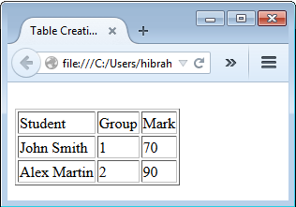
HTML Tables: Example
Student | Group | Mark
John Smith | 1 | 70
Alex Martin | 2 | 90
Data
Number(Rows and Columns)
Headings and its Locations
Formatting Cells & Borders
Table Caption
Table Structure
<TABLE border= “1”>
<TR>
<TD> Student </TD>
<TD> Group </TD>
<TD> Mark </TD>
</TR>
<TR>
<TD> John Smith </TD>
<TD> 1 </TD>
<TD> 70 </TD> </TR>
</TR>
<TR>
<TD> Alex Martin </TD>
<TD> 2 </TD>
<TD> 90 </TD>
</TR>
</TABLE>
Do not Forget to Add Basic HTML Tags
HTML Coding
Caption:
<caption>Table Title </caption>
Heading: <th></th> → Bold and Center

Slide 30
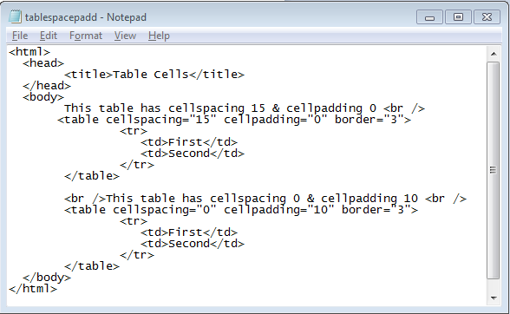
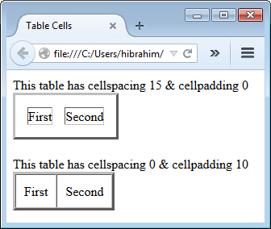
Border, Cell Spacing, and Padding
Cell Spacing: spaces between cells
Cell Padding: Spaces around cell data
align: left, center, or right
valign: top, middle, or bottom
width: pixel or percentage
Recommended to use CSS
30

Slide 31
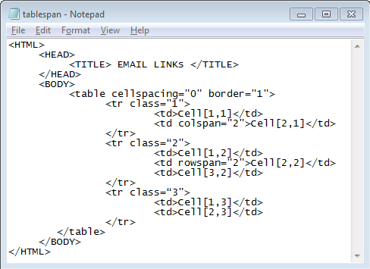
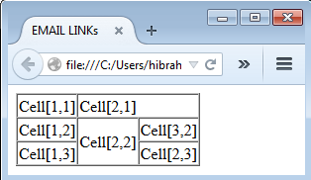
Column and Row Span – Example
Colspan & Rowspan Attributes
Spanning: Stretching over multiple cells

Slide 32
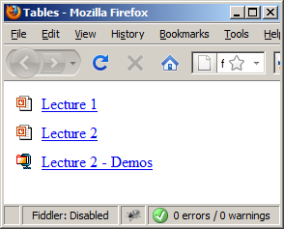
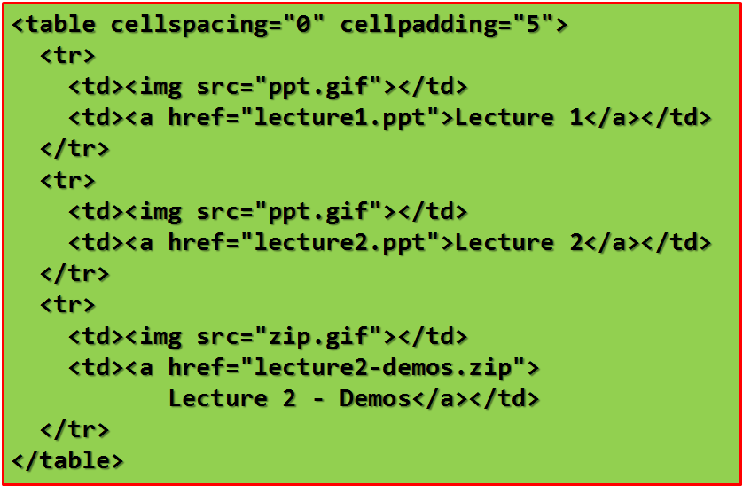
HTML Tables – Example
Image
Link

Slide 33
Graphics: Concepts
Image
Graphical Representation of a Thing & Graphical Element in a Web page.
File size should be small, otherwise page loading will be slow
Photoshop or GIMP can be used to edit images.
Quality, Copyright, and Consistency must be considered.
Image Types
JPG/JPEG: Joint Photographic Experts Group | Are highly compressed Support 16.7 million colors (24 bits per pixel) For more information on .jpgs see: http://www.w3.org/Graphics/JPEG/
PNG: Portable Network Graphics | Support indexed-color, greyscale and true color Depth from 1 – 16 bits Capable of transparency See http://www.w3.org/TR/REC-png.html for more w3 specs
Notes:
TYPES OF IMAGES
.gifs (“Graphic Interface Format”) are a WWW standard and come in 3 varieties:
Normal (87)
acts like a small .jpg, only 256 colors.
Transparent (89A)
invented in 1987 by Compuserve
8 bit color (2 to the 8th power = 256)
transparent background
interlacing
Animated
graphics that move on-screen

Slide 34
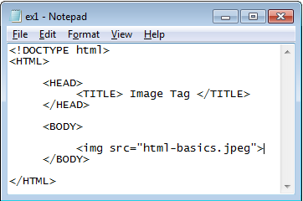
Images: IMG Tag
<IMG SRC=“image_source_file” />
SRC: Path to Image File or URL
Attributes
HTML & Image Files are in the Same Folder
SRC
ALT
Width
Height
File Location
Title
Image Dimensions
Alternative
# of Pixels
Image Tip Text

Slide 35
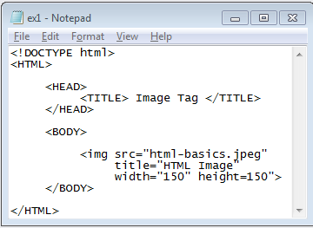
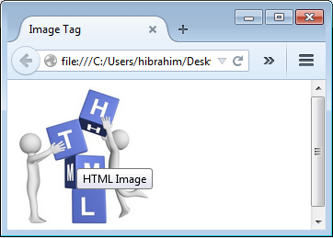
HTML IMG Tag: Title
Title Attribute
Title Value?

Slide 36
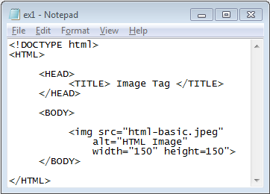
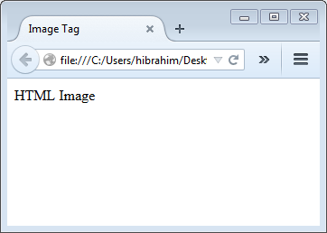
HTML IMG Tag: Alt
What about Alt Attribute?
Alt Value?
Misspelling: html-basics.jpeg

Slide 37
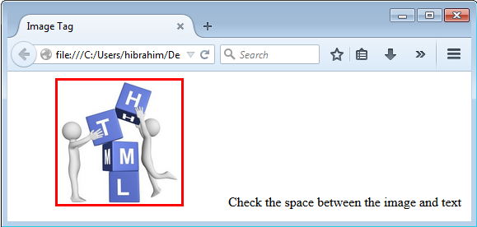
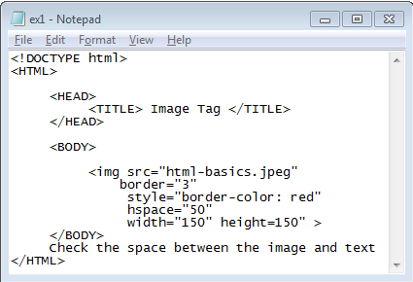
HTML IMG Tag: Hspace
HSPACE=“value”

Slide 38
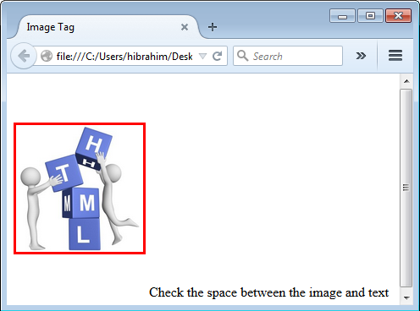
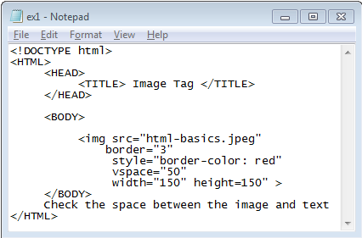
HTML IMG Tag: Vspace
VSPACE=“value”

Slide 39
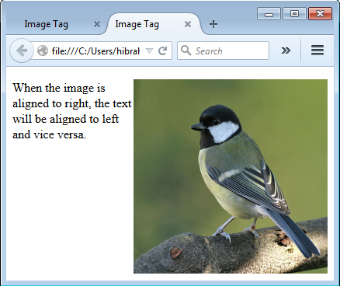
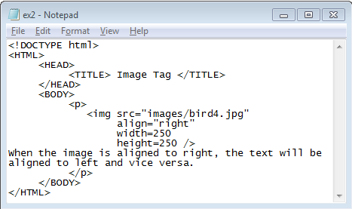
HTML IMG Tag: Align
Align=“right”
Image Aligned to Right
Text Aligned to Left

Slide 40
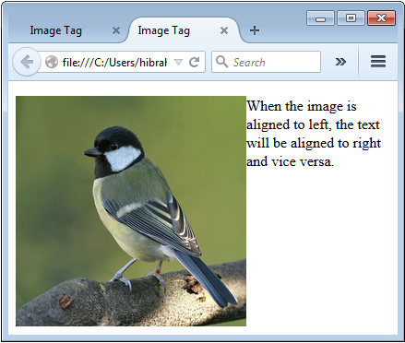
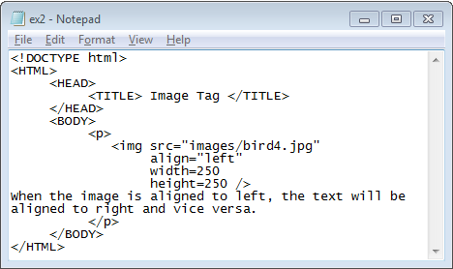
HTML IMG Tag: Example
Align=“left”
Image Aligned to Left
Text Aligned to Right

Slide 41
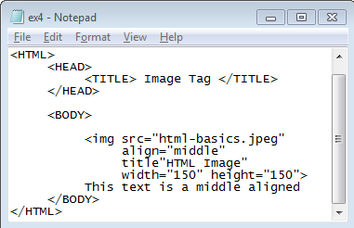
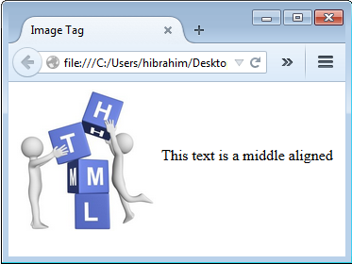
HTML IMG Tag: Align
Align=“middle”
Text Aligned to the Middle of the Picture
How about centering using HTML or CSS? (demo ex1 and ex1_css).

Slide 42
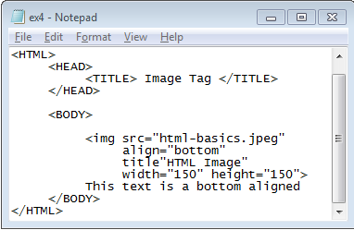
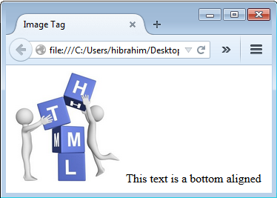
HTML IMG Tag: Align
Align=“bottom”
Text Aligned to the bottom of the Picture

Slide 43
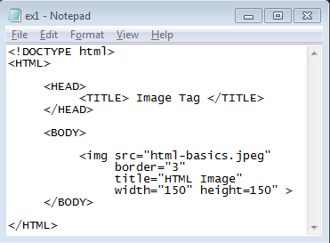
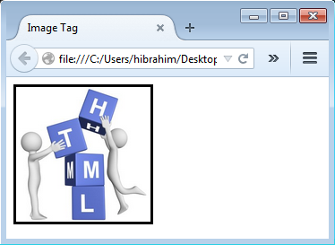
HTML IMG Tag: border
Border: Default (No Border)
3 Pixels Border

Slide 44
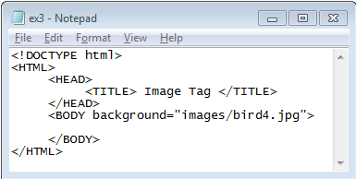
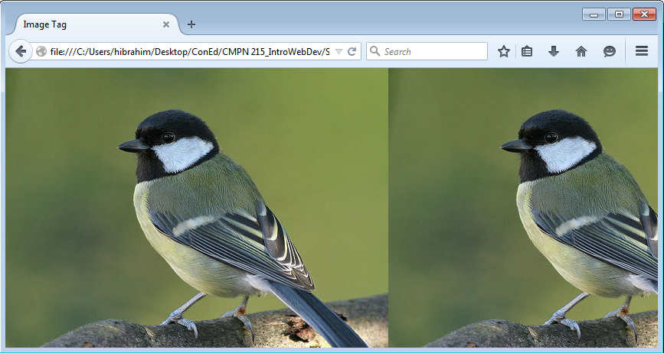
Image: Webpage Background

Slide 45
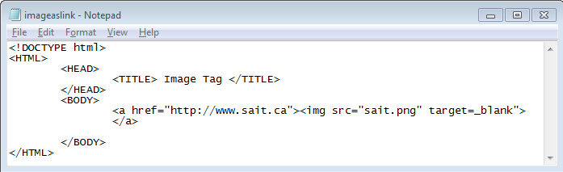
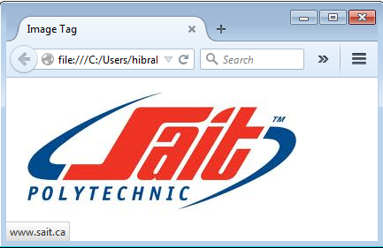
HTML IMG as a Link
Tiled Backgrounds
<body background=‘pic.jpg’>
Background colors
<body bgcolor=‘#000000’> -hex value
<body bgcolor=‘red’>
Notes:
Hyperlinked Images
<a href=‘http://www.somewhere.com’> <img src=‘pic.gif’ /> </a>
Thumbnails
<a href=‘bigpic.gif’><img src=‘pic.gif’></a>
Text Alternatives
<img src=‘pic.gif’ alt=‘this is a picture’ />

Slide 46

Icons: Test Yourself
Steps
Add link to icons library to HTML file
Use <i> or <span> to add icons
https://www.w3schools.com/icons/
Exercise
Do the exercises in “CPRG210 Exercises Day 1.doc”

